Slide 1
ANOVA FOR MACHINE LEARNING ALGORITHM PERFORMANCE
By: Nathan Baker

Slide 2
DESCRIPTION OF DATA
Example:
W/L,FG,FGA,FG%,3P,3PA,3P%,FT,FTA,FT%,ORB,TRB,AST,STL,BLK,TOV,PF,,OPPFG,OPPFGA,OPPFG%,OPP3P,OPP3PA,OPP3P%,OPPFT,OPPFTA,OPPFT%,OPPORB,OPPTRB,OPPAST,OPPSTL,OPPBLK,OPPTOV,OPPPF
L,32,73,.438,1,6,.167,22,31,.710,13,35,16,9,3,19,23,,35,76,.461,7,18,.389,21,26,.808,14,43,17,7,4,19,22
This data is taken from game logs for Oklahoma City Thunder games (from www.basketball-reference.com) across 7 seasons from 2008-2015 for 558 games
This data includes various game statistics like Field Goal Percentage (FG%), Steals (STL), and even opponent’s statistics like Opponent Turnovers (OPPTOV)
We use parts of this data to predict whether the Thunder will win or lose a game (depicted by W/L)
If we were to develop a model we could input projected game statistics and predict whether the Thunder will win a game that hasn’t even started yet

Slide 3
DESCRIPTION OF DATA (CONTINUED)
So how do we develop a model?
There are a few different methods of classification at our disposal
The two I will be using are called K-Nearest Neighbors and Logistic Regression in combination with 2 different combinations of parameters
After we develop our models we can test how well the models perform
We test their performance by creating the model using a random sample of 75% of the data and testing how accurate we can predict using the data from our holdout random sample of 25%
What we get is a percentage of how well our model has predicted the outcome of our test games
We do this 20 times for each possible Method:Model combination

Slide 4
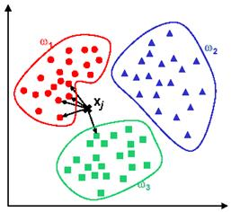
QUICK DESCRIPTION OF METHODS
Very simple and non-parametric classification algorithm
We essentially plot the data in hyperspace and declare each point as a certain class (in this case as a win or a loss)
For k = 1 nearest neighbors we plot the new data we don’t yet have a class for and calculate the “nearest” neighbor by Euclidean distance
If the nearest point is a Win we classify the new point as a win and vice versa with losses
For k = 5 nearest neighbors we do the same except we find the five nearest neighbors and classify based on a majority vote
Similarly for k = 7 nearest neighbors

Slide 5
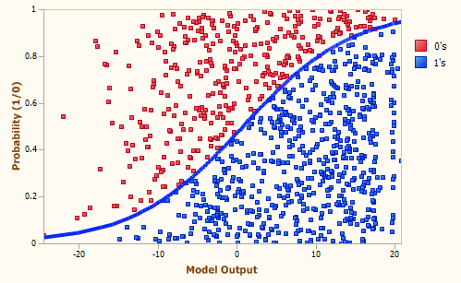
QUICK DESCRIPTION OF METHODS (CONT.)
Logistic regression is given by: Pr(Yi = 1 | Xi) = 1/[1+exp(-Beta*Xi)]
Essentially this gives us a probability that the Thunder will win a particular game on a scale of 0 to 1 (0 being a definite loss, 1 being a certain victory)
Given that our output is continuous, we need to create a classification rule
Our classification rule in this case is if the probability is >= 0.5 we classify the game as a win
If the probability is < 0.5 we classify the game as a loss

Slide 6
QUICK DESCRIPTION OF MODELS
Model 1: ORB + TRB + AST + STL + BLK + TOV + PF + OPPORB + OPPTRB + OPPAST + OPPSTL + OPPBLK + OPPTOV + OPPPF
We use our different methods given these parameters to create our predictions
We do the same for Model 2
Model 2: TRB + AST + STL + BLK + OPPTRB + OPPAST + OPPSTL + OPPBLK
A description of the actual parameters: ORB = Team Offensive Rebounds, TRB = Team Total Rebounds, AST = Team Assists, STL = Team Steals, BLK = Team Blocks, TOV = Team Turnovers, PF = Team Personal Fouls, OPPORB = Opponent Offensive Rebounds, OPPTRB = Opponent Total Rebounds, OPPAST = Opponent Assists, OPPSTL = Opponent Steals, OPPBLK = Opponent Blocks, OPPTOV = Opponent Turnovers, OPPPF = Opponent Personal Fouls

Slide 7
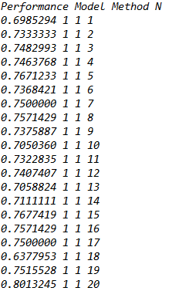
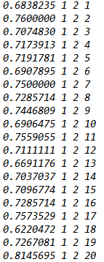
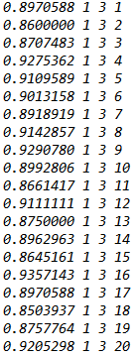
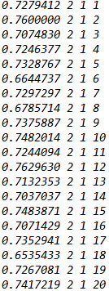
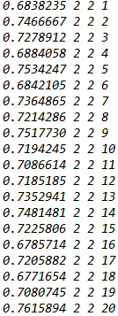
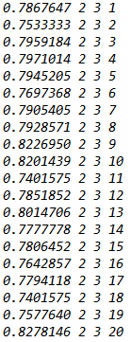
ANALYZING THE DATA
Some example data (pre-transform: 120 data points)
Note that Model 1 and 2 were given in the previous slide; Method 1 is 5NN, Method 2 is 7NN, Method 3 is Logistic Regression

Slide 8
DESCRIPTION OF ANOVA MODEL
We want to know which Model:Method combination has the best average performance
Since we are analyzing specifically each model and method we use a fixed effects model with b = 3 for the method levels and a = 2 for the model levels
Each cell will have 20 tests of the performance
We will also need to perform a transform
Since the data is essentially a proportion of the games each model predicted correctly, they are generated using a binomial distribution
Because of this the mean is equal to n*p and the variances are n*p*(1-p)
Thus if the means are different then the variances are likely different as well contradicting our assumption of homogenous variances
So before our analysis we perform a simple 2*arcsin(sqrt()) transform
Note that this also coincidentally should correct any lack of normality

Slide 9
ANALYZING THE DATA
Anova Model
 | 5NN | 7NN | Logistic Regression
Model 1 | Cell (1,1) | Cell (1,2) | Cell (1,3)
Model 2 | Cell (2,1) | Cell (2,2) | Cell (2,3)

Slide 10
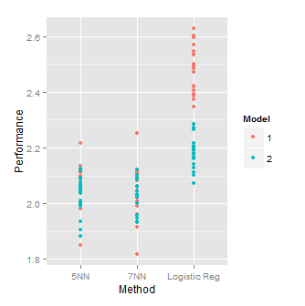
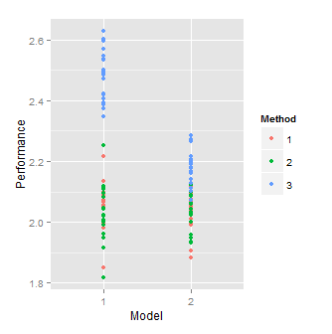
ANALYZE THE DATA
Some preliminary data visualization using the R package “ggplot2”
Note these appear different than proportions because of the transform

Slide 11
ANALYZING THE DATA
Preliminary Model Means and Boxplots
Note that values are above 1 because of the 2*arcsin(sqrt()) transform applied to the data
 | Means Table (Pre Transform)
Grand Mean: | 0.7626791
Model Means: | Model 1 | Model 2
 | 0.7837 | 0.7417
Method Means: | 5NN | 7NN | Logistic Regression
 | 0.7291 | 0.7196 | 0.8393
Cell Means | 5NN | 7NN | Logistic Regression
Model 1 | 0.7368 | 0.7196 | 0.8947
Model 2 | 0.7214 | 0.7196 | 0.7839
 | Means Table (Post Transform)
Grand Mean: | 2.135091
Model Means: | Model 1 | Model 2
 | 2.1926 | 2.0776
Method Means: | 5NN | 7NN | Logistic Regression
 | 2.0480 | 2.0269 | 2.3304
Cell Means | 5NN | 7NN | Logistic Regression
Model 1 | 2.0656 | 2.0273 | 2.4849
Model 2 | 2.0305 | 2.0264 | 2.1759

Slide 12
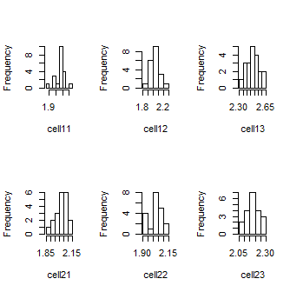
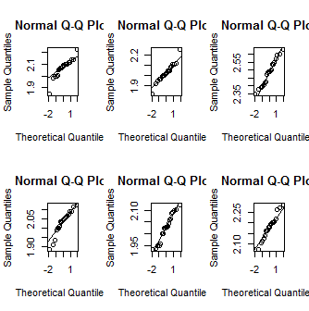
HISTOGRAMS AND QQ BETWEEN CELLS

Slide 13

TESTS FOR HOMOGENEITY OF VARIANCES
We use Bartlett’s test for homogeneity of variances
Since our p-value = .3365 > 0.05 or 0.10 we fail to reject H0 at either significance level
H0 is the null-hypothesis of equal variances

Slide 14
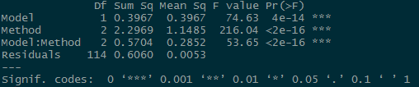
ANOVA TABLES
Here are the ANOVA tables for the entire model and the interaction as well as the Model and Methods alone
From the total model we can conclude that H0: (αβ)ij = 0 can be rejected meaning the factors do interact
The p-value for Factor A (Model) is small so we can reject H0: αI = 0
The p-value for Factor B (Method) is small so we can reject H0: βj = 0
We conclude that the data suggest a difference in means between every cell

Slide 15
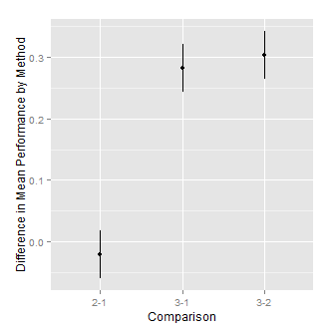
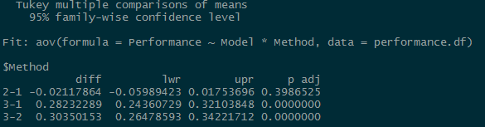
QUANTIFYING MEAN DIFFERENCES
We use Tukey’s method to show a difference in contrasts across the Method levels
Here is the Tukey multiple comparisons of means for Methods (Recall Method 1 is 5NN, Method 2 is 7NN, and Method 3 is Logistic Regression)
We see the Confidence intervals for the mean of method 3 minus the mean of methods 1 and 2 and both fairly positive
This suggests that Method 3 in general performed better that both methods 1 and 2
Also, it seems that there is not a very significant difference between the performance of methods 1 and 2

Slide 16
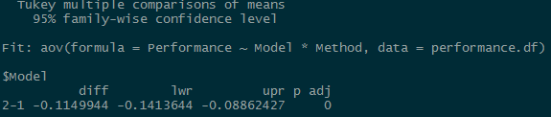
QUANTIFYING MEAN DIFFERENCES (CONT.)
We now use Tukey’s method for comparing the means of the model levels
As you can see, the mean performance for model 2 minus the mean performance for model 3 yields an entirely negative confidence interval
The confidence however is somewhat close to 0
This suggest that model 1 only slightly outperforms model 2 in terms of prediction

Slide 17
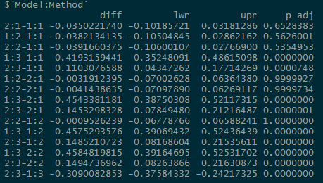
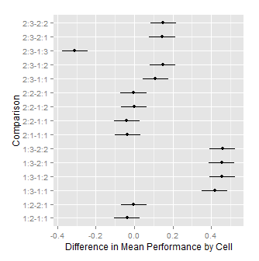
QUANTIFYING MEAN DIFFERENCES (CONT.)
From these Tukey contrasts between cells its easy to see that the combination of Model 1 with Method 3 is consistently the best performing model:method combination

Slide 18
CONCLUSION
From our analysis we can conclude that Logistic Regression has performed consistently better than either of 5NN or 7NN
We can also conclude that Model 1 is a slightly better than model to use than Model 2
And lastly the combination of Logistic Regression with Model 1 is by and large the best prediction model of those tested (this model had an average of 89.47 % correct prediction rate across approximately 140 games)

